Slide 1
Classification of Osteoporosis Bone Disease using an advanced Deep-Learning
Under the supervision of
Dr. P Praveen(Mr. Md.Sallauddin)Asst. Professor, Department of CSE.
Associate Professor School of
Computer Science & Artificial Intelligence
Presented for
Milestone 3-Final Minor Project Review
Date:26-04-2024
Candidate No. & Name
HTNO. | Name
2103A52037 2103A52047 2103A52051 2103A52095 2103A52186 | U. Reethu Varma Ch. Preethi K. Srinidhi M. Ananya Darshini N. Anuhya

Slide 2
Abstract
Osteoporosis, a common skeletal disorder characterized by reduced bone mineral density and increased bone fragility, poses a significant global health concern. Early detection and accurate classification of osteoporosis are crucial for effective intervention and prevention of associated fractures. Traditional diagnostic methods, such as dual-energy X-ray absorptiometry (DXA), have limitations in terms of precision and accessibility. In recent years, advanced deep-learning techniques have emerged as promising tools for the automated and accurate classification of medical conditions, including osteoporosis.

Slide 3
Introduction
Osteoporosis, a prevalent skeletal disorder characterized by reduced bone mineral density and increased fracture risk, poses a significant public health concern. Accurate and timely classification of osteoporosis is crucial for early intervention and effective management. This project's main objective is to develop a deep learning model that creates a scalable and reliable method for correctly detecting osteoporosis, which will eventually improve patient outcomes and care. To predict osteoporosis, we used a variety of deep learning and classification models, including Random Forest, ADABoost, Decision Tree, Logistic Regression, SVM, KNN, Neural Network Classifier, Navie Bayes, VGG16, CNN, and VGG19. Using measures like precision, recall, f1 score, ROC AUC score, and accuracy score, we assessed the effectiveness of various deep learning and classification models. Methods for addressing data augmentation, duplicate data, missing data, and scaling or normalizing data are also included in the project. The dataset used for this project includes the x-rays and CT scans of the knees of the various patients.
The proposed model utilizes state-of-the-art deep learning techniques to extract meaningful features from bone imaging modalities. Training on diverse datasets, the model demonstrates promising results in accurately categorizing bone health status. The results of this research help us identify the best model, which is a scalable and reliable method for the detection of osteoporosis. In conclusion, it helps organizations improve patient outcomes. It enables more efficient and accessible healthcare solutions for individuals at risk of osteoporosis, enhances healthcare efficiency, leads to better-informed clinical decisions, and advances our understanding and management of osteoporosis.

Slide 4
Motivation
Our team selected this osteoporosis classification project because, as a group of CSE students who feel passionate about enhancing technology to improve healthcare outcomes, we decided to take on this osteoporosis classification project. Because of the possibility that this would increase the rates of early diagnosis, which would benefit patients and lessen the cost of healthcare. Moreover, the group is certain that working on this project will improve their deep learning skills and knowledge, especially when it comes to medical image analysis. It provides a chance to take on a challenging issue and come up with creative solutions that match our goals and abilities. Additionally, this project is a beginning toward achieving our goals as individuals and as a group in the field of AI in healthcare. It was chosen because it combines our team interests, skills, ambitions, and passion for making a meaningful impact in the field of healthcare.

Slide 5
Literature Review
The literature on the diagnosis and treatment of osteoporosis covers a wide range of methodologies, from state-of-the-art deep learning and machine learning techniques to conventional risk assessment tools. Numerous research explore the use of deep learning architectures and machine learning algorithms to the prediction of osteoporosis, emphasizing the use of various medical imaging data types, such as MRIs, CT scans, X-rays, and DEXA scans.
Models such as the MVCT network, Osteo-Net, and 4x-expert system have been proposed by researchers and have shown good accuracy in identifying osteoporosis from various kinds of medical imaging. These models deliver state-of-the-art performance by utilizing sophisticated approaches including multi-view representation learning modules, deep learning architectures with skip connections, and multi-model machine learning algorithms.
Additionally, research has looked into how to improve accuracy by integrating clinical covariate data with radiography pictures and using artificial intelligence to predict bone mineral density levels. Using methods such as feedforward feature extraction networks, osteoporosis has been diagnosed using quantitative computed tomography (QCT) images with excellent accuracy and reliable bone density estimation.

Slide 6
Existing System
The existing approach uses a variety of advanced deep learning methods to reliably identify osteoporosis using imaging data obtained from medical tests. Modern deep learning architectures, including as long short-term memory (LSTM) networks, recurrent neural networks (RNNs), convolutional neural networks (CNNs), and hybrid models, are included into the system.
Existing osteoporosis diagnosis systems face a number of difficulties, such as the requirement for large and diverse datasets for deep learning algorithms, interpretability and generalizability issues, reliance on expensive imaging modalities, and the requirement for validation and standardization across various populations and healthcare contexts.

Slide 7
Objective
This project's main objective is to develop a deep learning model that creates a scalable and reliable method for correctly detecting osteoporosis, which will eventually improve patient outcomes and care.

Slide 8
Dataset
Our data was used to develop a system for early prediction of osteoporosis. It suggests information about patients who diagnosed with osteoporosis and potentially healthy controls. This dataset contains images of X-rays. Our Original dataset consists of 372 normal images and 372 Osteo images. Images in our dataset are in the form of JPG, PNG and JPEG format.
We performed image augmentation, this technique is used in object detection tasks which increases the size and diversity of our dataset which aims to improve the robustness and generalizability of an object detection model. After performing all these techniques the augmented data consists of 1860 Normal images and 1860 Osteo images.
In order to classify osteoporosis using deep learning, data processing is an essential step. We used different preprocessing techniques to improve quality and consistency of our data

Slide 9
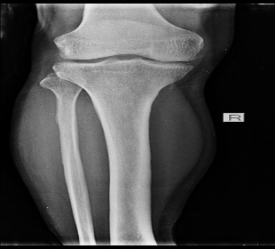
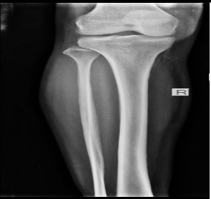
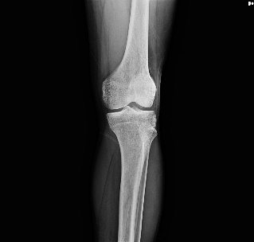
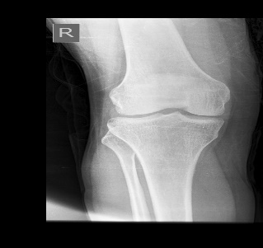
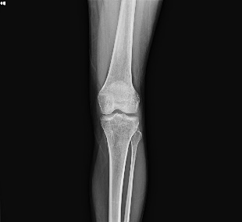
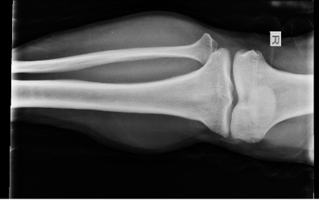
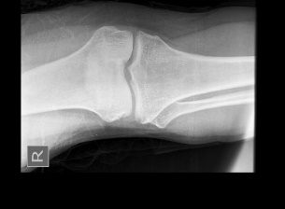
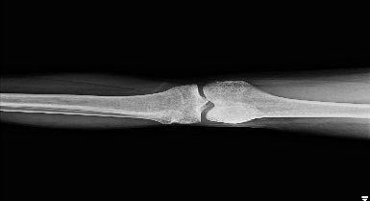
Original Images
Healthy
Osteoporosis
Augmented Images
Healthy
Osteoporosis

Slide 10
Proposed Methodology
The proposed methodology aims to develop a robust deep learning model for osteoporosis detection leveraging knee CT scans. The process begins with comprehensive data collection, comprising images from patients with both osteoporosis and normal bone density. Subsequently, meticulous data preprocessing steps are undertaken, including pixel value normalization, noise elimination, contrast enhancement, and standardization of image sizes. The dataset is then divided into training, validation, and testing sets. Various machine learning and deep learning techniques, such as SVM, NNC, AdBoast, KNN, and CNNs, are explored for classification, alongside evaluating pre-trained models like ResNet and VGG16. During model training, efforts are made to mitigate overfitting through techniques like data augmentation and hyperparameter tuning via grid search and Bayesian optimization. Finally, model performance is evaluated using a range of metrics including ROC curve, F1-score, recall, accuracy, precision, and confusion matrix computation, ensuring a comprehensive assessment of the model's efficacy across different classes. This methodology promises to deliver a scalable and reliable solution for accurately detecting osteoporosis, thus potentially improving patient outcomes and healthcare delivery.

Slide 11
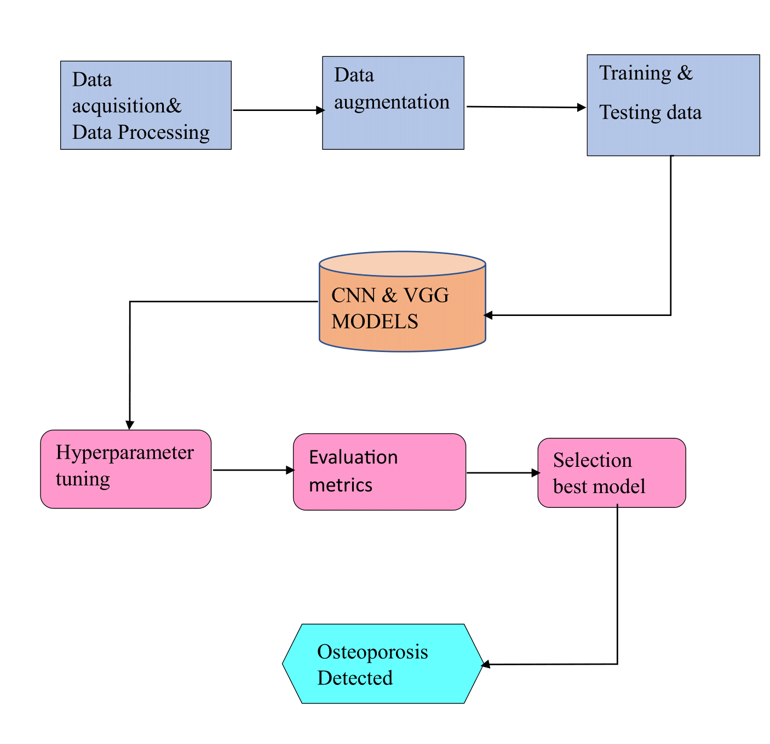
Architecture of Proposed System

Slide 12
Implementation
The workflow begins with preprocessing X-ray images and organizing them into labelled datasets. Various machine learning models like logistic regression, KNN, SVM, naive Bayes, random forest, neural network, AdaBoost, and decision tree are applied, with accuracies ranging from 75.27% to 88.17%.
Then, deep learning models like CNN and VGG-16 are employed. For CNN, data is organized into training, testing, and validation sets using Data Frame. The model consists of convolutional layers with ReLU activation, batch normalization, max-pooling, dense layers with dropout for regularization, and softmax activation for classification. The CNN is compiled with categorical cross-entropy loss and SGD optimizer. Overall, this CNN model is well-suited for image classification tasks like osteoporosis detection.

Slide 13
Results
Evaluation Metrics
.
MODELS | PRECISION | RECALL | F1 SCORE | ROC | ACCURACY_SCR
LR | 0.8652 | 0.8370 | 0.8508 | 0.8546 | 0.8548
KNN | 0.7193 | 0.8913 | 0.7961 | 0.7754 | 0.7742
SVM | 0.8119 | 0.8913 | 0.8497 | 0.8446 | 0.8441
NB | 0.6627 | 0.5978 | 0.6286 | 0.6500 | 0.6505
RF | 0.8539 | 0.8261 | 0.8398 | 0.8439 | 0.8441
NNC | 0.8795 | 0.7935 | 0.8343 | 0.8435 | 0.8441
DT | 0.8276 | 0.7826 | 0.8045 | 0.8115 | 0.8118
ADA | 0.8193 | 0.7391 | 0.7771 | 0.7898 | 0.7903
CNN | 0.93 | 0.93 | 0.93 | 0.9330 | 0.9327
VGG16 | 0.92 | 0.92 | 0.92 | 0.9187 | 0.9204
VGG19 | 0.86 | 0.85 | 0.85 | 0.8561 | 0.9062

Slide 14
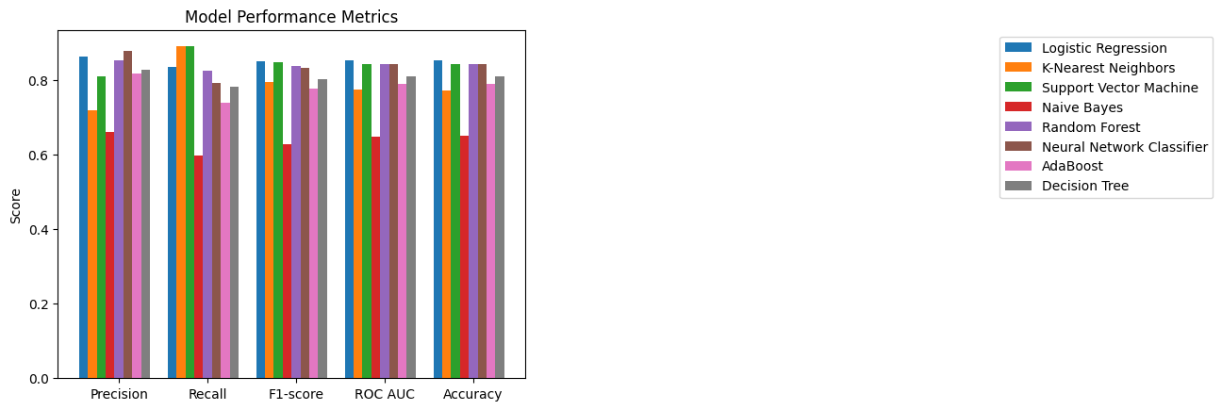
Results
Evaluation Metrics Graph for ML Models
Accuracies for ML Models
.
Models | Training Accuracy | Testing Accuracy | Overall Accuracy
LR | 0.9802 | 0.8548 | 0.9489
KNN | 0.8476 | 0.7741 | 0.8333
SVM | 0.9211 | 0.8440 | 0.9018
NB | 0.7168 | 0.6505 | 0.7029
RF | 0.9802 | 0.8440 | 0.9448
NNC | 0.9677 | 0.8279 | 0.9327
DT | 0.9802 | 0.8064 | 0.8951
ADA | 0.9749 | 0.7956 | 0.9233

Slide 15
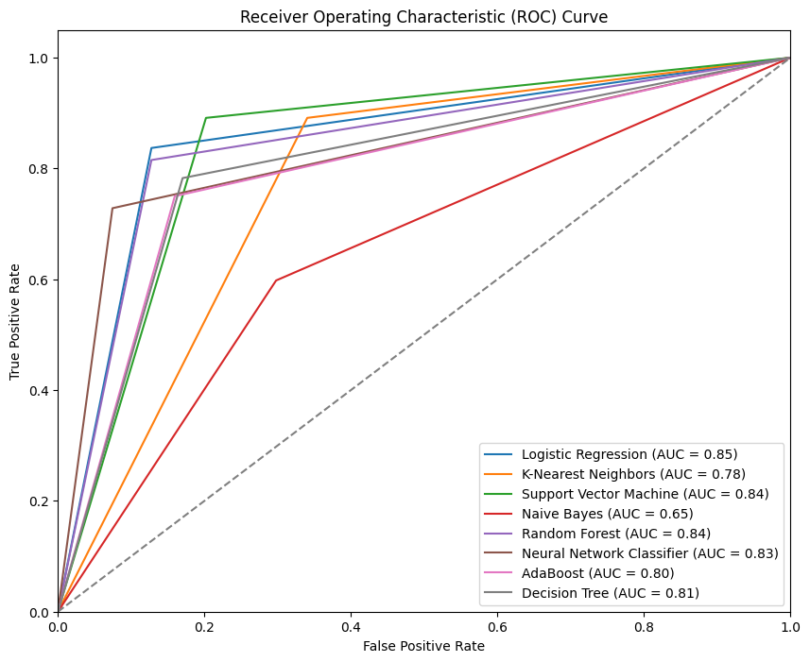
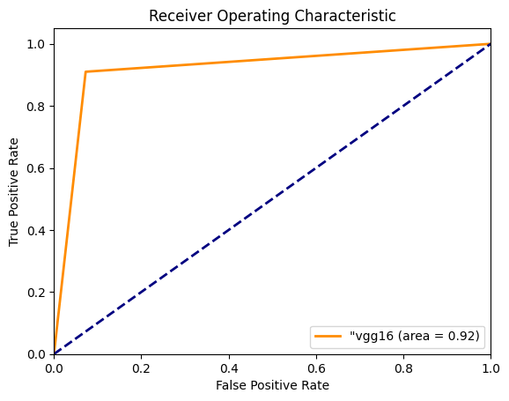
Results
.
ROC Curves for Ml Models
ROC Curve for VGG16

Slide 16
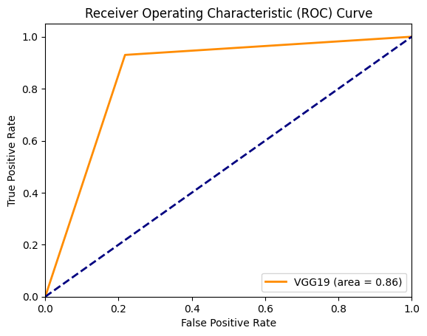

Results
.
ROC Curve for VGG19
ROC Curve for CNN

Slide 17
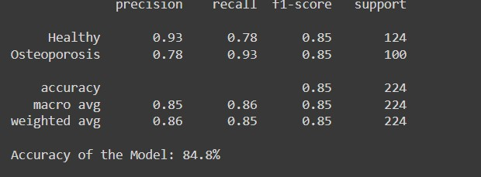
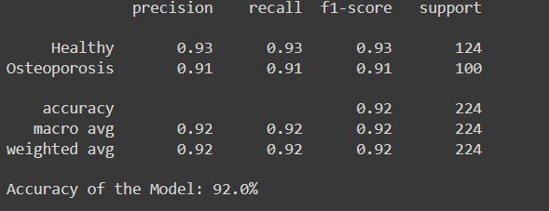
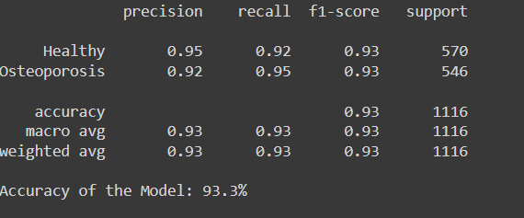
Results
VGG19 :
VGG16 :
CNN :

Slide 18
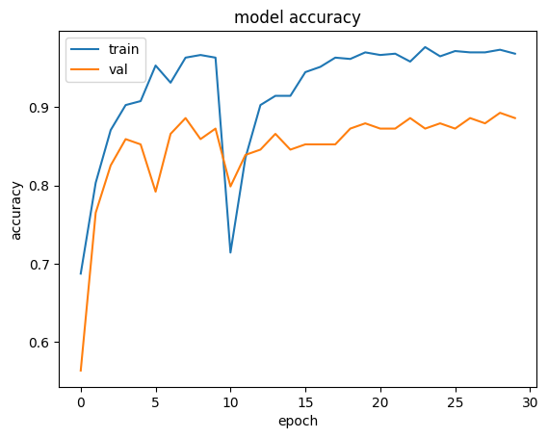
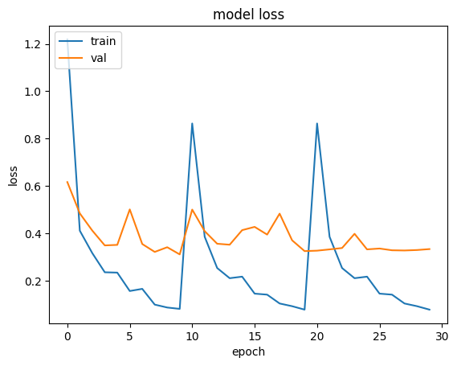
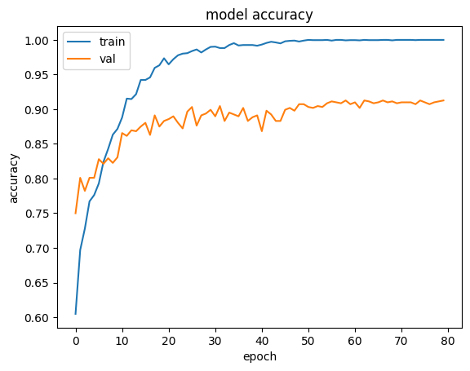
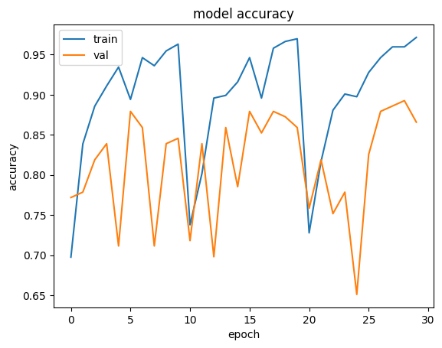
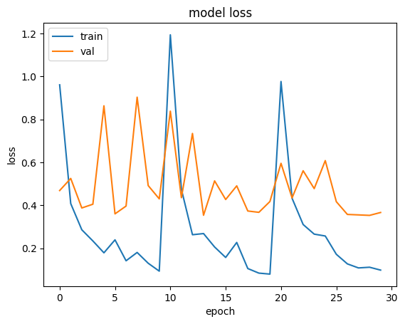
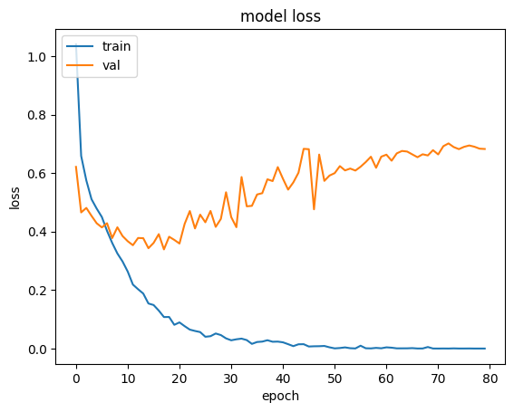
Results
Model Accuracy & Loss for VGG16
Model Accuracy & Loss for CNN
Model Accuracy & Loss for VGG19

Slide 19
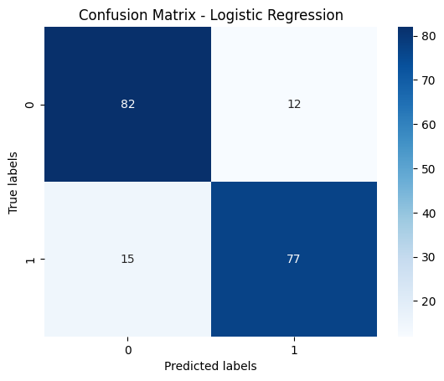
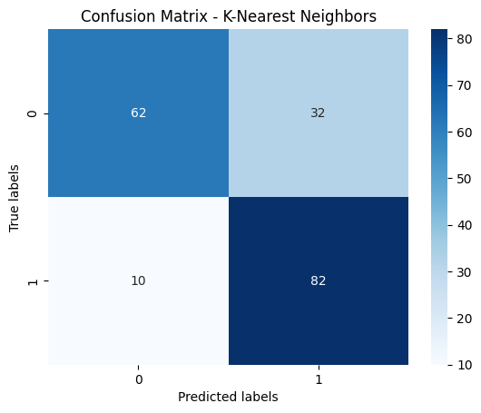
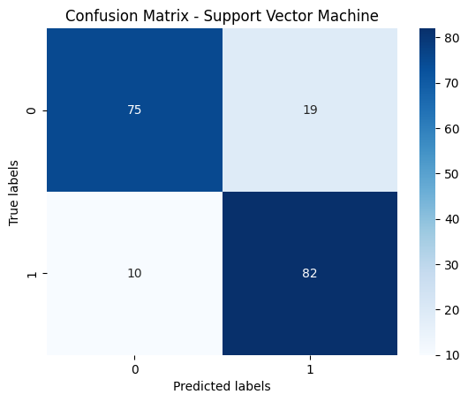
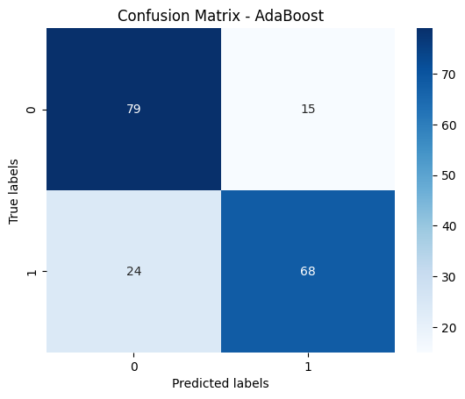
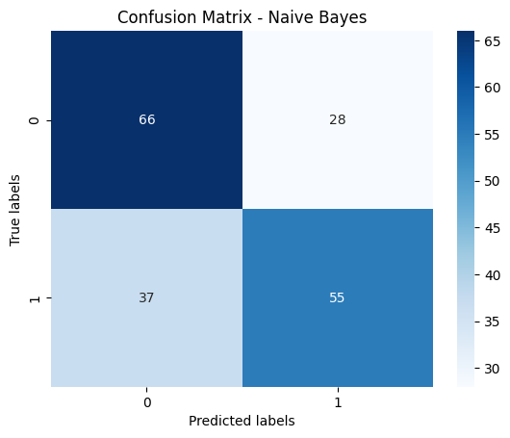

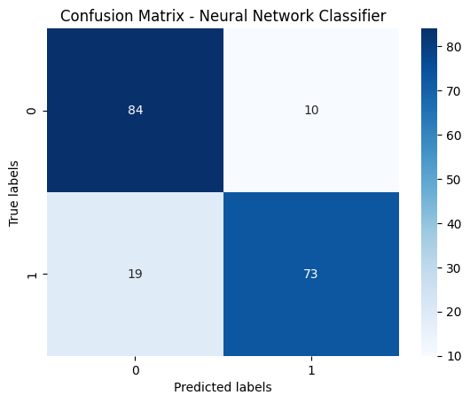

Results
Confusion Matrix

Slide 20
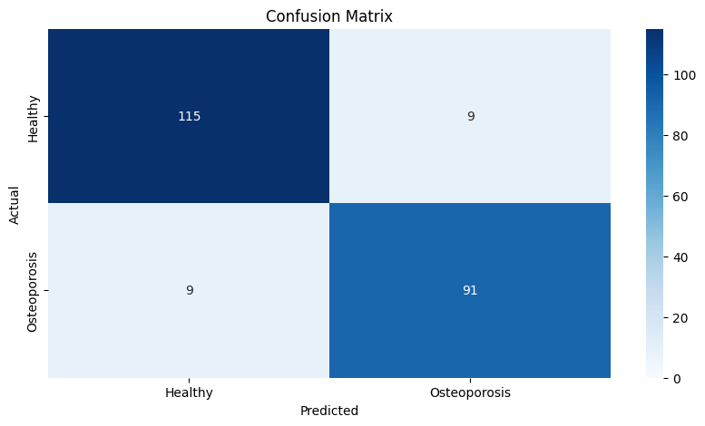
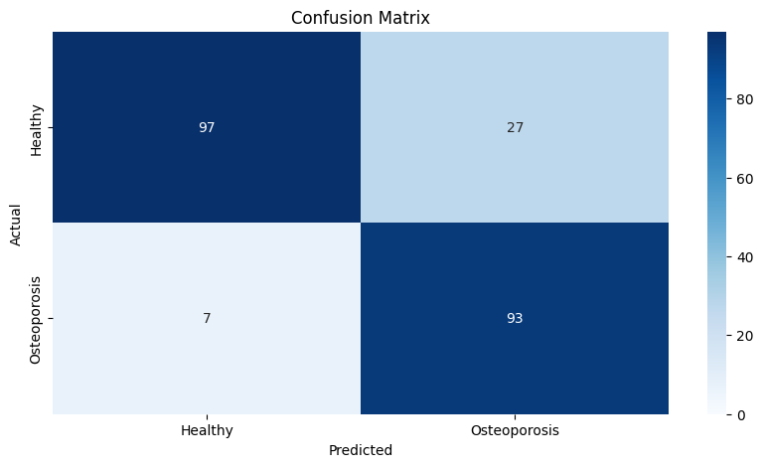
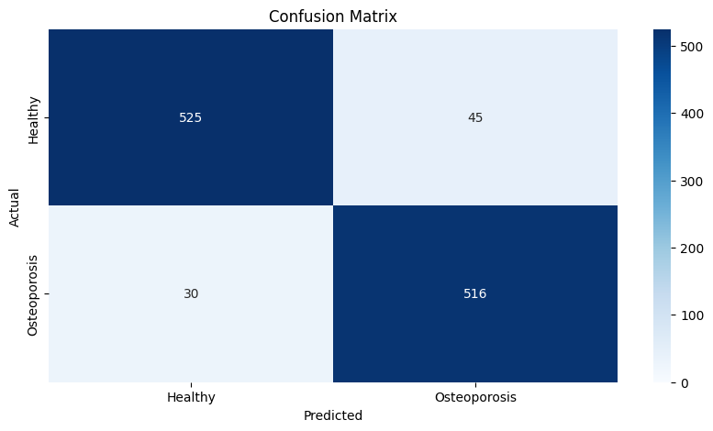
Results
VGG16
VGG19
CNN

Slide 21
Results
“CNN" holds the top position in maintaining a high level of performance. Because it has the least loss and highest accuracy. As a result, CNN fits the model very well, with an Accuracy of 93.3%.

Slide 22
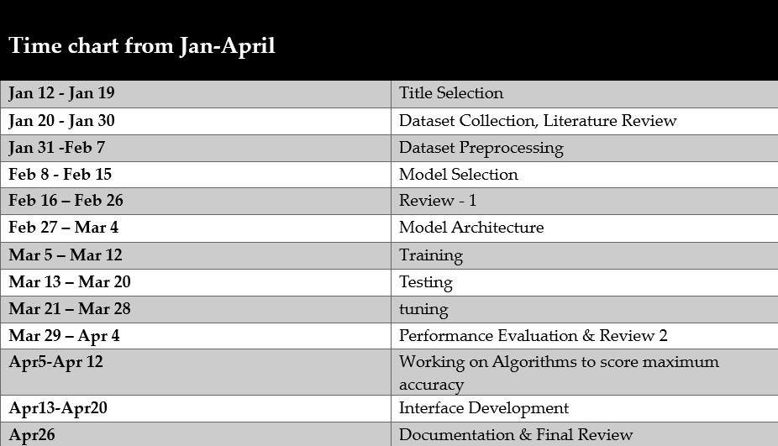
Timeline & Work Plan/ Progress

Slide 23
Conclusions
In this analysis, we analyzed that sophisticated deep learning methods can effectively classify osteoporosis bone condition. Through the use of advanced algorithms and large-scale datasets, we have made significant progress in predictive diagnosis and classification. Our results highlight deep learning's potential as a useful tool for improving osteoporosis detection and management, which will eventually lead to better patient outcomes.

Slide 24
Future Scope
Improving model performance can involve fine-tuning deep learning architectures, fine-tuning hyperparameters, and including other data modalities such as genetic markers or medical pictures. While personalized medicine techniques might enhance treatment plans based on specific patient profiles, the development of real-time diagnostic technologies could transform the diagnosis and planning of osteoporosis. While long-term monitoring might offer insights into how a therapy is responding to a patient's illness and development over time, integration with healthcare systems would guarantee widespread acceptance. Investigating multimodal data fusion might improve diagnosis accuracy by capturing the intricate interactions between variables that underlie osteoporosis.

Slide 25
References
Sandhu, S. K., & Hampson, G. (2011). The pathogenesis, diagnosis, investigation and management of osteoporosis. Journal of clinical pathology, 64(12), 1042-1050.
Sözen, T., Özışık, L., & Başaran, N. Ç. (2017). An overview and management of osteoporosis. European journal of rheumatology, 4(1), 46.
Wihandika, R. C., Arifin, A. Z., & Yuniarti, A. (2018, June). Detection of Branching in Trabecular Bone Using Multiscale COSFIRE Filter for Osteoporosis Identification. In Proceedings of the 4th International Conference on Frontiers of Educational Technologies (pp. 147-151).
Prakash, U. M., Kottursamy, K., Cengiz, K., Kose, U., & Hung, B. T. (2021). 4x-expert systems for early prediction of osteopor Wihandika, R. C., Arifin, A. Z., & Yuniarti, A. (2018, June). Detection of Branching in Trabecular Bone Using Multiscale COSFIRE Filter for Osteoporosis Identification. In Proceedings of the 4th International Conference on Frontiers of Educational Technologies (pp. 147-151).osis using multi-model algorithms. Measurement, 180, 109543
Ramesh, T., & Santhi, V. Multi-level classification technique for diagnosing osteoporosis and osteopenia using sequential deep learning algorithm. International Journal of System Assurance Engineering and Management, 15(1), 412-428.

